Slide 1
Blockchainia
A Web3 Gaming Distribution and Online Multiplayer Gaming Infrastructure
Ed Anderson 13 Feb 2023

Slide 2
What Gamers Want
Our Niche
Current “web 2.0” Competition lacks:
Tradable in-game items
A consumer palatable Value Proposition
Free-to-play, $20 per skin, $DLC
Convenience

Slide 3
Blockchainia (Arcade style JRPG)
How it works!
Seasonal Releases explore chronological scenes
Players Progress through 8 levels
One level released each season
Replay to rise in the leaderboards To play, create and connect a blockchain wallet, and pay GAME_PRICE set by the Game Server.
Will translate to full scale VR port after successful initial campaign

Slide 4

Blockchainia (Arcade style JRPG)
To Build Community
Pay-to-Play
Configurable price
Earn back tokens in-game
Players can also mint Environment Enemies
Earn tokens Offline
Portion of game fee is dropped by player on elimination

Slide 5
Pay Per Play? Will consumers go back?
Cryptocurrencies + 90s Arcade + Living room + Online Multiplayer
Pay Per Play
1994, NBA Jam
1.1 Billion from 20,000 cabinets
25 cents per game/51 cents today=
VR Indie Developers create arcade-scale games
Indie Developers struggle to compete with AAA gaming studios:
Distribution
Scale

Slide 6
DeathToll
“If you build it, they will come.”
Web3 Arcade PvPvE VR Arena Looter Shooter
Acade style VR Battle Royale
Player lounges (Server Lobbies)
Seasonal Updates
Features are Community Driven
On-Blockchain DAO
Discord

Slide 7
What Now?
$30,000
Establish MVP and Initial Sprint Cycle Velocity
Hardware/Software
Servers/Nodes
Developer Tools
Set deliverables
Establish velocity
Scale active users with deliverables
Set trajectory

Slide 8

Where do we go from here?
On Successful Demo
Development
Development. Costs: $22,698
Market Research
Market Research - Test Live Gameplay
Measure engagement time
Projected Cost: $11,400
Total (Estimated): $34,098

Slide 9
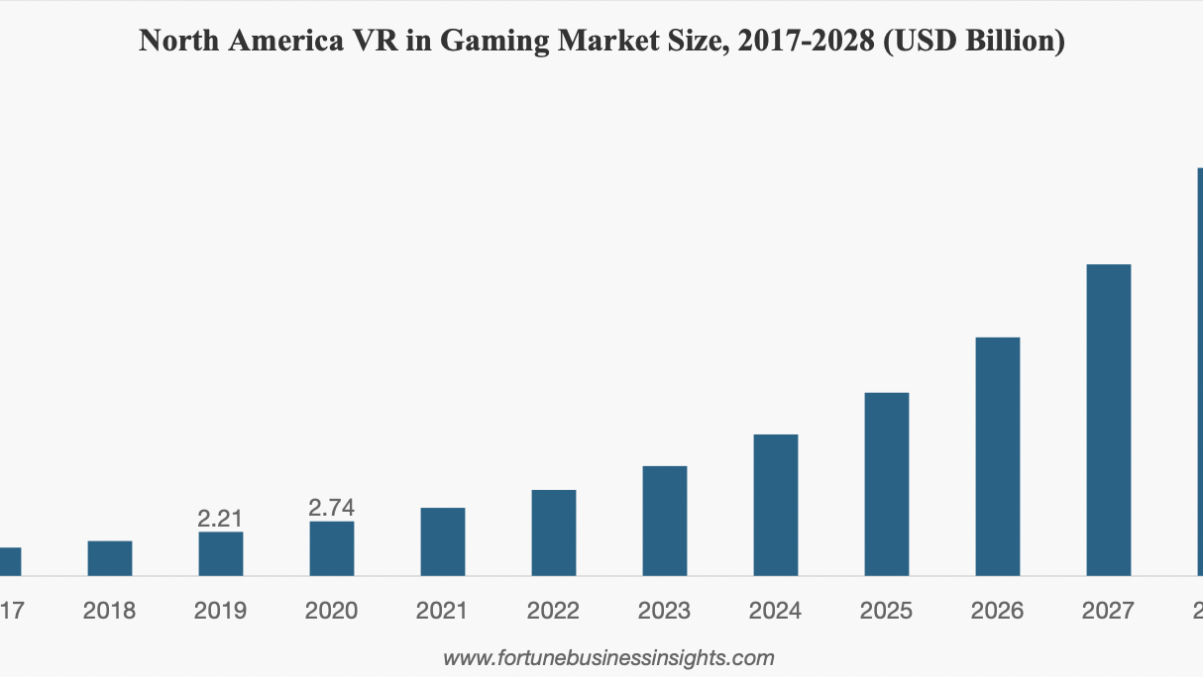
Projected Revenue from Live MVP
Per NFT Collection Release
Game Development Revenue (NFT Playable Characters) for One Game
NFTs in Collection | Bundle Price | Quantity per Purchase | Total Revenue
100,000 | $3.00 | 1 | $300,000
100,000 | $12.00 | 3 | $400,000
100,000 | $15.00 | 5 | $300,000

Slide 10
What Next?
Projected Potential Revenue: Online Multiplayer Community
(Per Server Projections)
Projected Online Multiplayer Infrastructure Revenue ($USD)-1
Price per Game | Daily Active User Projection Low | Daily Active User Projection High | Average Game_Length | Total Minutes Engaged Low | Total Minutes Engaged Low | Weekly Revenue Low | Weekly Revenue High | Yearly Revenue Low | Yearly Revenue High
$0.03 | 200 | 2000 | 1m | 3 | 15 | $18 | $900 | $936 | $46,800
$0.03 | 200 | 2000 | 3m | 15 | 60 | $30 | $1,200 | $1,560 | $62,400
$0.10 | 200 | 2000 | 1m | 3 | 15 | $60 | $3,000 | $3,120 | $156,000
$0.10 | 200 | 2000 | 3m | 15 | 60 | $100 | $4,000 | $5,200 | $208,000
$0.25 | 200 | 2000 | 1m | 3 | 15 | $150 | $7,500 | $7,800 | $390,000
$0.25 | 200 | 2000 | 3m | 15 | 60 | $250 | $10,000 | $13,000 | $520,000
NFTs in Collection NFT Price Quantity per Purchase
10,000 $3.00 1 $30,000
100,000 $12.00 5 $240,000
1,000,000 $10.00 5 $2,000,000z

